Slide 1
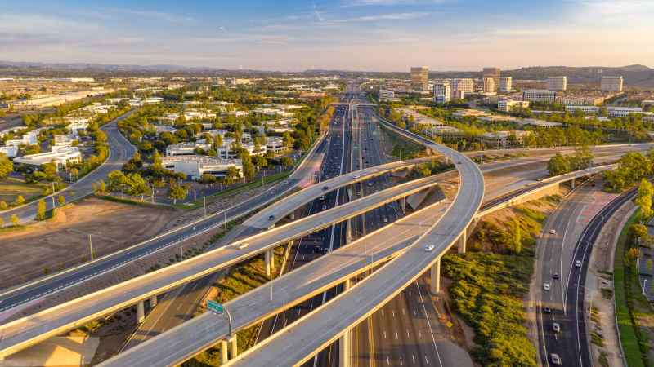
UAV-BASED ROAD INSPECTION AND ANALYSIS FOR SMART CITIES USING MACHINE LEARNING
Department of Applied Data Science,
San Jose State University
DATA 298B: MSDA Project II
Project Advisor: Dr. Jerry Gao
- GROUP 5
DAMINI PRASHANT VICHARE, MANISHA LAGISETTY,
SWEEKRUTHI BALIVADA, YUTING SHA

Slide 2
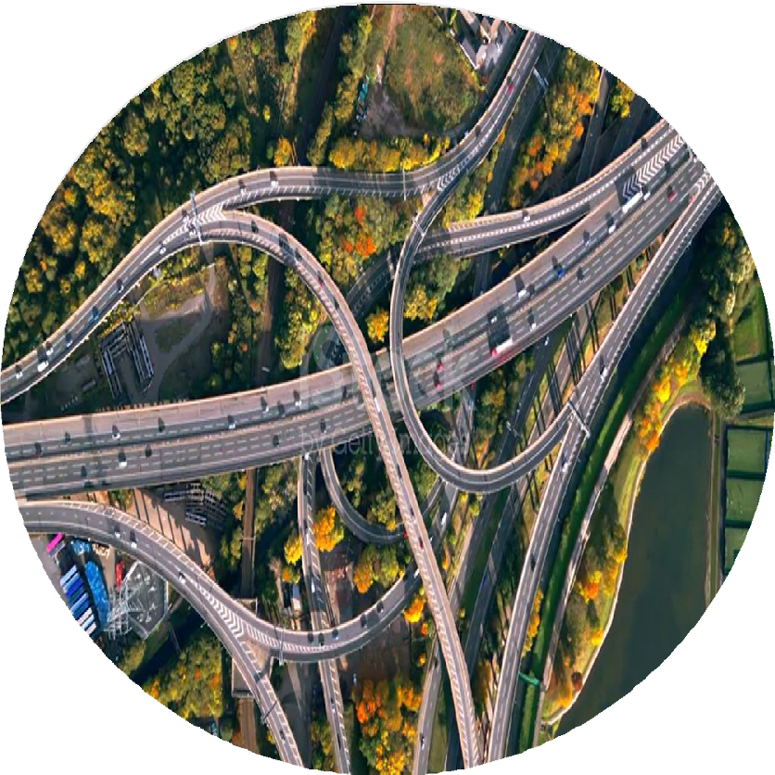
Table Of Contents
Project Introduction
Project background and Motivation
Data Engineering
Machine Learning Modeling
Machine Learning Evaluation Results
Web Portal System Development
System Demo and Testing
Literature and Technology Survey

Slide 3





TEAM ORGANIZATION & FUNCTION ROLES
Each team member is responsible for:
•Engaging in research efforts, gathering relevant literature and exploring innovative technologies.
•Participating in developing a comprehensive plan for the project, aligning with objectives and incorporating research insights.
•Taking part in the development phase, overseeing the creation of software components and resolving technical challenges.
•Contributing to testing activities, ensuring the quality of deliverables and addressing any issues identified during testing.
•Share responsibility for project management and coordination, organizing meetings and monitoring progress.

Slide 4
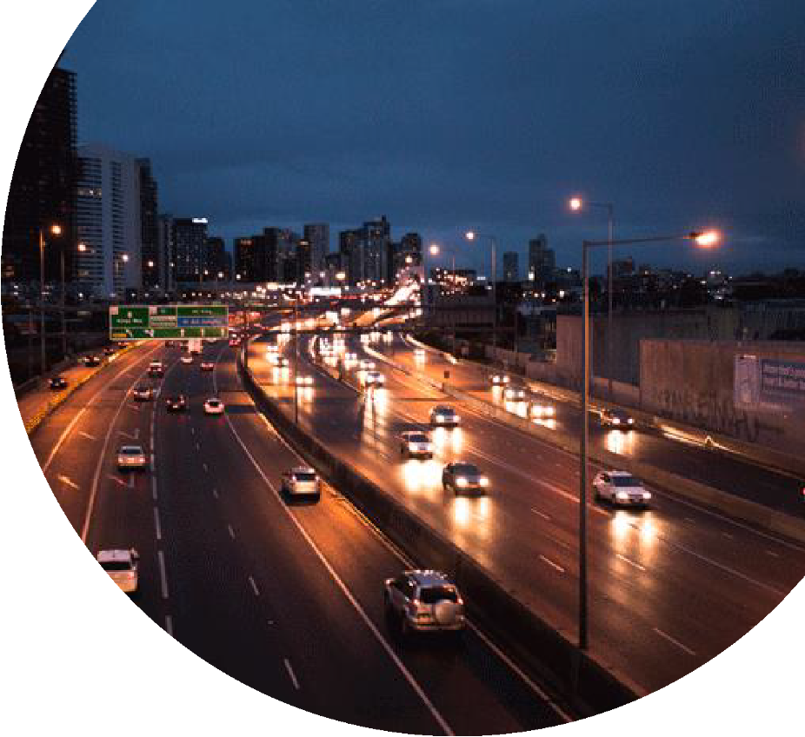
Project Introduction
The primary goal of this project is to revolutionize urban transportation management by leveraging cutting-edge machine learning techniques.
Our system focuses on identifying and assessing the severity of road anomalies—such as potholes, cracks, construction activities, wildlife, and illegal dumping—that impact traffic safety and flow.
By utilizing UAVs for data collection and advanced machine learning models like YOLO v8, Faster R-CNN, MB1- SSD and Vision Transformers, we aim to deliver a real-time solution that supports city planners in prioritizing road maintenance tasks.
Through an intuitive web application, our system offers an interactive dashboard where authorities can visualize anomalies on a city map, filter by severity, and generate actionable insights.
By providing timely and precise information, our project empowers urban authorities to make informed decisions, ensuring safer and more efficient transportation networks in smart cities.

Slide 5
Road Anomalies in the USA: Statistics
Road Anomaly | Frequency | Impact
Potholes | Occurrence Rate: ~40–80 potholes per 100 miles. | Annual Repair Costs: ~$5 billion nationally.
Cracks | Occurrence Rate: ~100–200 cracks per 100 miles. | Annual Repair Costs: ~$4 billion–$6 billion nationally.
Illegal Dumping | ~20–30 incidents per 100 miles. | Clean-Up Costs: ~$50 million annually across the U.S.
Car Accidents | ~35–50 accidents per 100 miles annually. | Economic Impact: Vehicle repairs and associated costs exceed ~$3 billion annually.
Construction | Active Zones: ~10–25 per 100 miles at any given time. Average Project Duration: 4–6 months. | Accidents in Construction Zones: Total annual construction zone crashes: ~102,000 incidents (nationwide). Fatalities: ~850 annually.
Notes:
References
Federal Highway Administration (FHWA)
Website: https://www.fhwa.dot.gov/
Reports on roadway conditions, maintenance costs, and repair frequency.
American Society of Civil Engineers (ASCE) - Infrastructure Report Card
Website: https://www.infrastructurereportcard.org/
Data on national road maintenance, costs, and funding gaps.
National Highway Traffic Safety Administration (NHTSA)
Website: https://www.nhtsa.gov/
Statistics on accidents related to road anomalies.
TRIP - A National Transportation Research Nonprofit
Website: https://tripnet.org/
Reports on road conditions, costs of repairs, and impacts on drivers.
Local and State Department of Transportation Reports
Example: California DOT, Texas DOT, etc.
Specific reports on pothole and crack repair statistics by region.
Transportation Research Board (TRB)
Website: https://www.trb.org/
Research papers on crack and pothole occurrence, repair methods, and costs.
Public Works Agencies
Example: Municipal Public Works Department reports for urban data (e.g., Chicago, NYC).
Data on illegal dumping, construction zones, and localized road anomalies.

Slide 6
Road Anomalies in the San Jose: Statistics
Road Anomaly | Frequency | Impact
Potholes | Occurrence Rate: ~50–100 potholes per 100 miles (higher in areas with older road infrastructure). | Annual Repair Costs: Estimated at ~$50–$100 million for the San Jose area.
Cracks | Occurrence Rate: ~150–250 cracks per 100 miles (due to wear and tear from weather and high vehicle density). | Annual Repair Costs: ~$30–$50 million locally.
Illegal Dumping | ~Frequency: ~10–20 incidents per 100 miles. | Clean-Up Costs: ~$2–$5 million annually (managed by local waste services and public works).
Car Accidents | Frequency: ~40–60 accidents per 100 miles annually. | Economic Impact: ~$100–$150 million annually for vehicle repairs and emergency services.
Construction | Active Zones: ~15–30 per 100 miles at any given time (due to ongoing urban development and road repairs). Average Project Duration: 3–5 months. | Accidents in Construction Zones: Total annual construction zone crashes: ~1,000–1,200 incidents in San Jose. Fatalities: ~10–15 annually.
Notes:
References
Federal Highway Administration (FHWA)
Website: https://www.fhwa.dot.gov/
Reports on roadway conditions, maintenance costs, and repair frequency.
American Society of Civil Engineers (ASCE) - Infrastructure Report Card
Website: https://www.infrastructurereportcard.org/
Data on national road maintenance, costs, and funding gaps.
National Highway Traffic Safety Administration (NHTSA)
Website: https://www.nhtsa.gov/
Statistics on accidents related to road anomalies.
TRIP - A National Transportation Research Nonprofit
Website: https://tripnet.org/
Reports on road conditions, costs of repairs, and impacts on drivers.
Local and State Department of Transportation Reports
Example: California DOT, Texas DOT, etc.
Specific reports on pothole and crack repair statistics by region.
Transportation Research Board (TRB)
Website: https://www.trb.org/
Research papers on crack and pothole occurrence, repair methods, and costs.
Public Works Agencies
Example: Municipal Public Works Department reports for urban data (e.g., Chicago, NYC).
Data on illegal dumping, construction zones, and localized road anomalies.

Slide 7
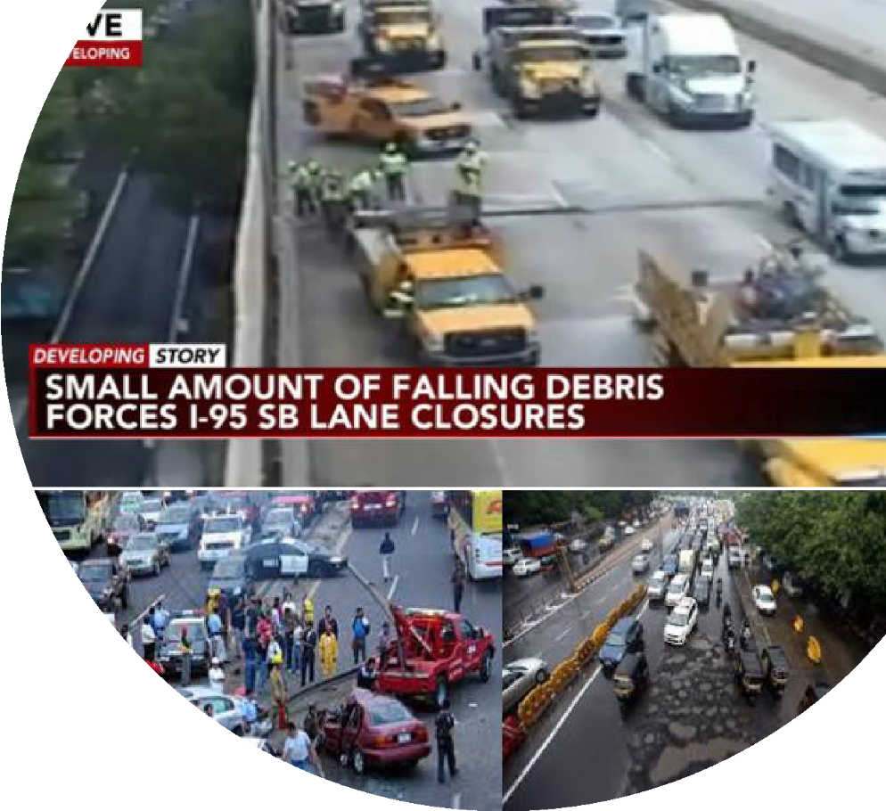
Project Background and
Motivation
The rapid urbanization of cities has led to an increase in traffic volume and heightened dependency on well-maintained road infrastructure. However, road anomalies such as potholes, cracks, and obstructions often go unnoticed until they cause significant damage, disrupt traffic flow, or lead to safety hazards.
Traditional methods of road inspection are labor-intensive, time-consuming, and often fail to provide real-time insights, making it challenging for city planners to prioritize maintenance effectively.
Our motivation stems from the urgent need for a smarter, more efficient solution to this problem—one that leverages cutting-edge technology to enhance transportation management.
By combining UAVs for data collection and AI-powered machine learning models, we aim to provide city authorities with real-time detection and severity estimation of road anomalies.

Slide 8
Project Objectives and Needs
Objective | Details
Enhance Road Safety | Detect road anomalies like potholes, cracks, and debris in real-time to reduce traffic accidents.
Improve Transportation Management | Provide actionable insights to prioritize and schedule road maintenance tasks effectively.
Automated Anomaly Detection | Use advanced ML models (YOLOv5, YOLOv8, SSD, Vision Transformers) for accurate anomaly detection.
Severity Estimation | Classify detected anomalies into severity levels (low, medium, high) for prioritization.
Scalable System Design | Build a cloud-based system to handle large datasets collected by UAVs.
User-Friendly Interface | Develop an intuitive web dashboard for displaying anomalies, locations, and generating reports.
Real-Time Data Processing | Ensure timely updates from UAV-captured images for proactive road condition management.
Need | Details
Advanced Machine Learning Models | Implement state-of-the-art AI models for anomaly detection and severity estimation.
Data Collection and Storage | Use UAVs for high-resolution image collection and Google Cloud Storage for scalability.
Backend System | Utilize Flask for integrating ML models and managing data pipelines.
Interactive Dashboard | Use React for visualization and enabling anomaly filtering and reporting.
Integration via APIs | Employ FAST APIs for smooth backend-to-frontend communication.
Real-Time Insights | Process UAV-captured images and update the dashboard in real-time.
Scalability and Flexibility | Design the system to adapt to larger urban areas and future expansions.

Slide 9
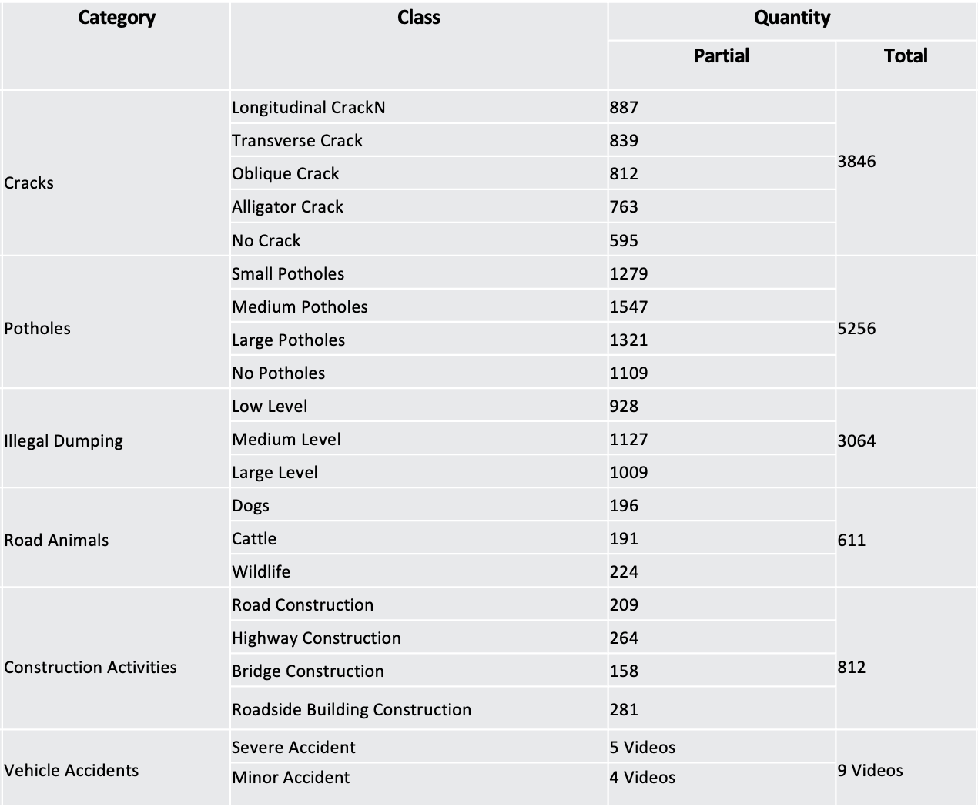
Data Engineering

Slide 10
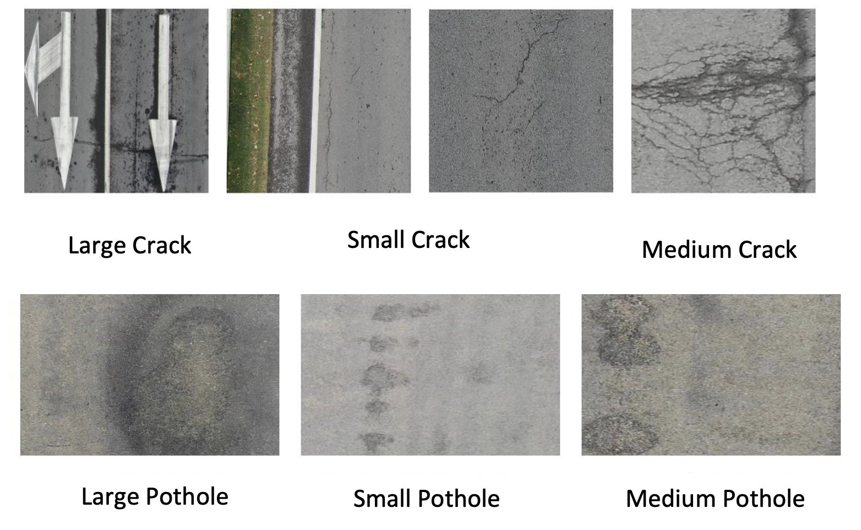
Data Samples - Cracks and Potholes

Slide 11
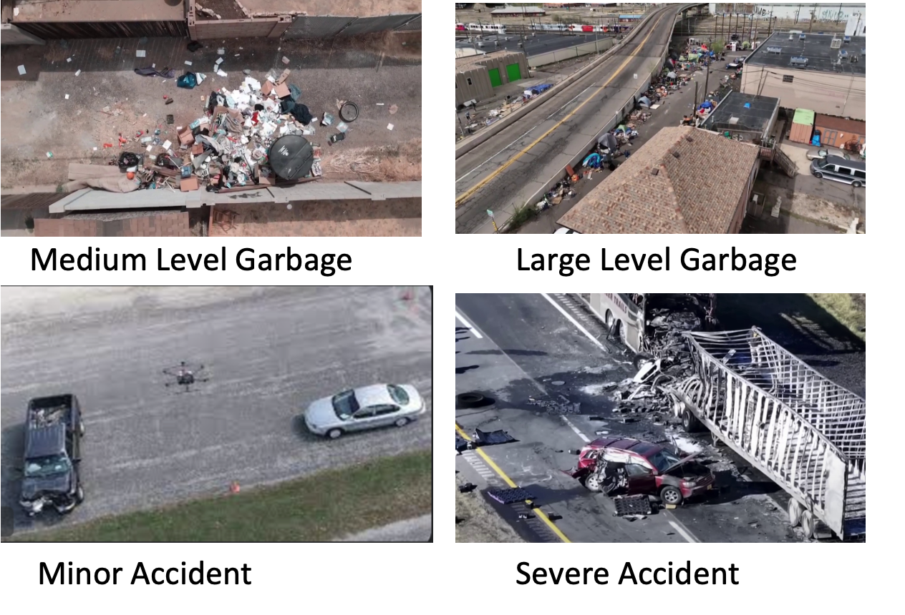
Data Samples -Illegal Dumping and Car Accidents

Slide 12
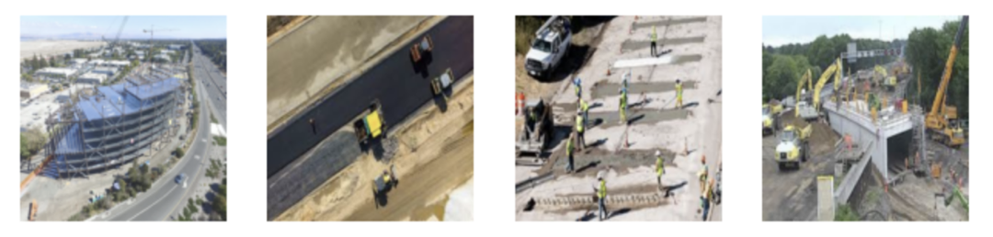
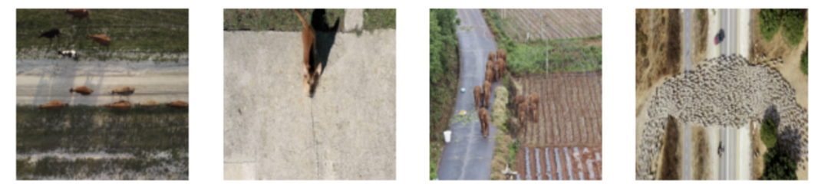
Data Samples -Construction Objects and Wild Animals

Slide 13
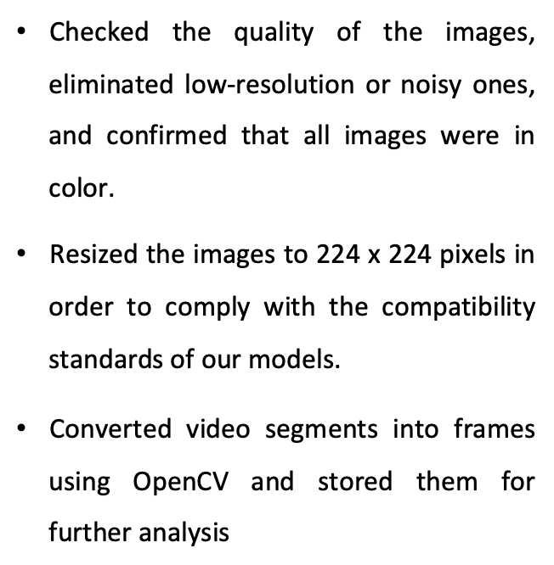
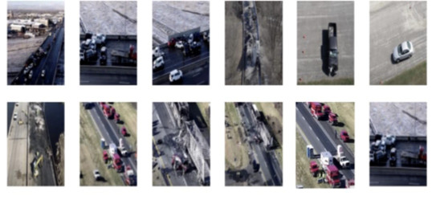
Data Preprocessing

Slide 14
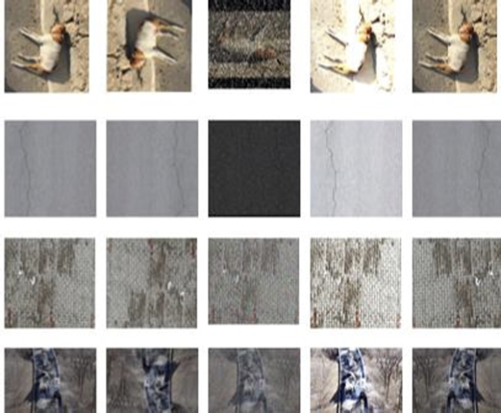
Data Transformation
•Utilized a range of image data augmentation methods, such as rotation, adjusting brightness, translation, scaling, flipping
•Employing these techniques serves to diversify and improve the dataset, enhancing the model's capacity to adapt to various scenarios, to cover all possible angles of anomalies and effectively manage real world variations.

Slide 15
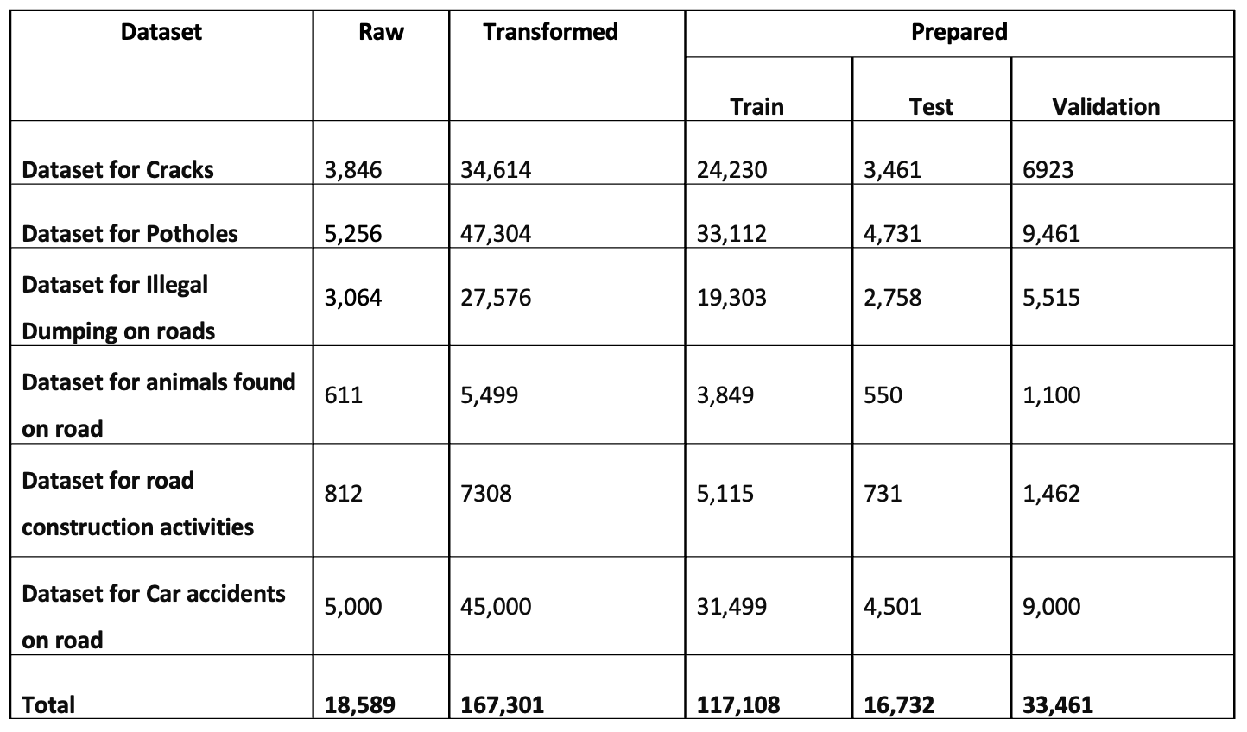
Data After Transformations

Slide 16
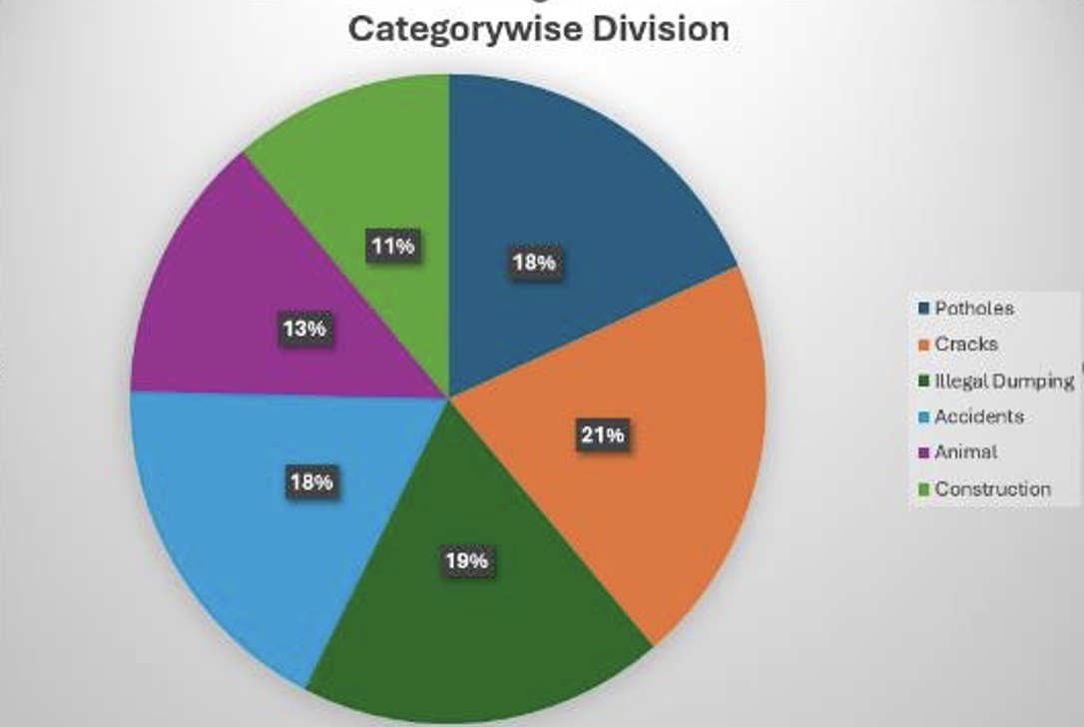
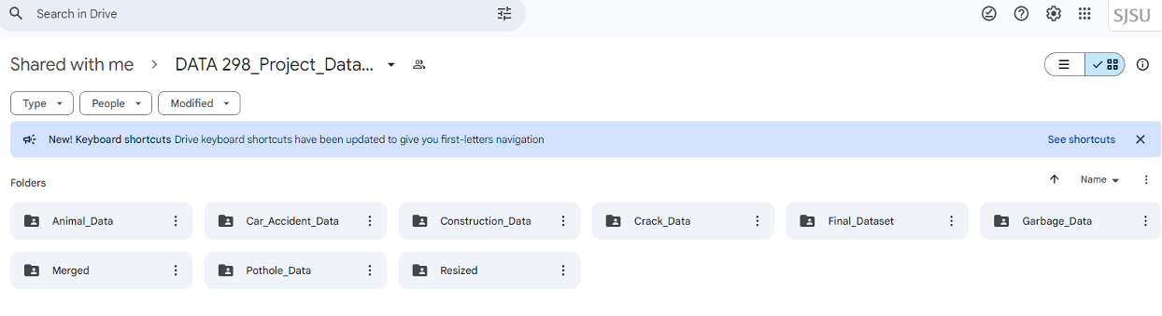
Data Splitting
•A 70-20-10 split ratio was maintained while paying careful attention to annotation. Sample datasets were provided for visualization purposes.
•This ensures the model has sufficient data to learn, validate its performance, and test its generalization.
•Files are moved into appropriate directories after splitting.
•Directories: train/images, train/labels, valid/images, valid/labels, etc.

Slide 17
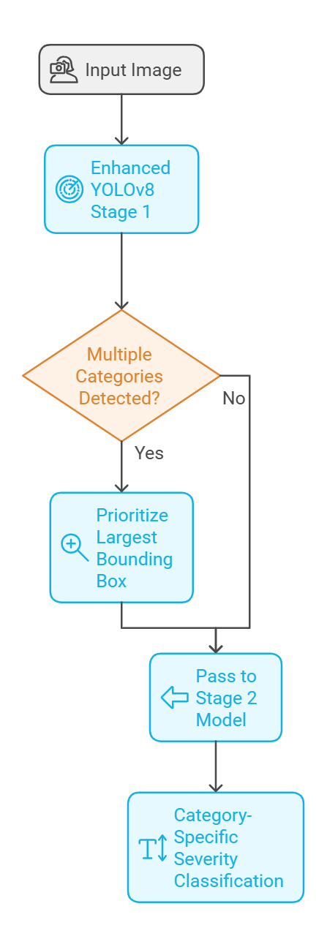
Modelling
In our project we have divided the modelling into 2 stages in order to improve efficiency.
Stage 1 modelling consists of Improved yolo v8 model. Model architecture along with input and output is shown in next slides. The improvisation made in the baseline model is highlighted.
In Stage 2 modelling we have 6 different models corresponding to our 6 obstacle categories namely Animals, Construction, Potholes, Vehicle Collisions, Cracks and Illegal dumping.
For stage 2 we have chosen 2 baseline models – Vision Transformer and MobileNet-Single shot Multibox.

Slide 18
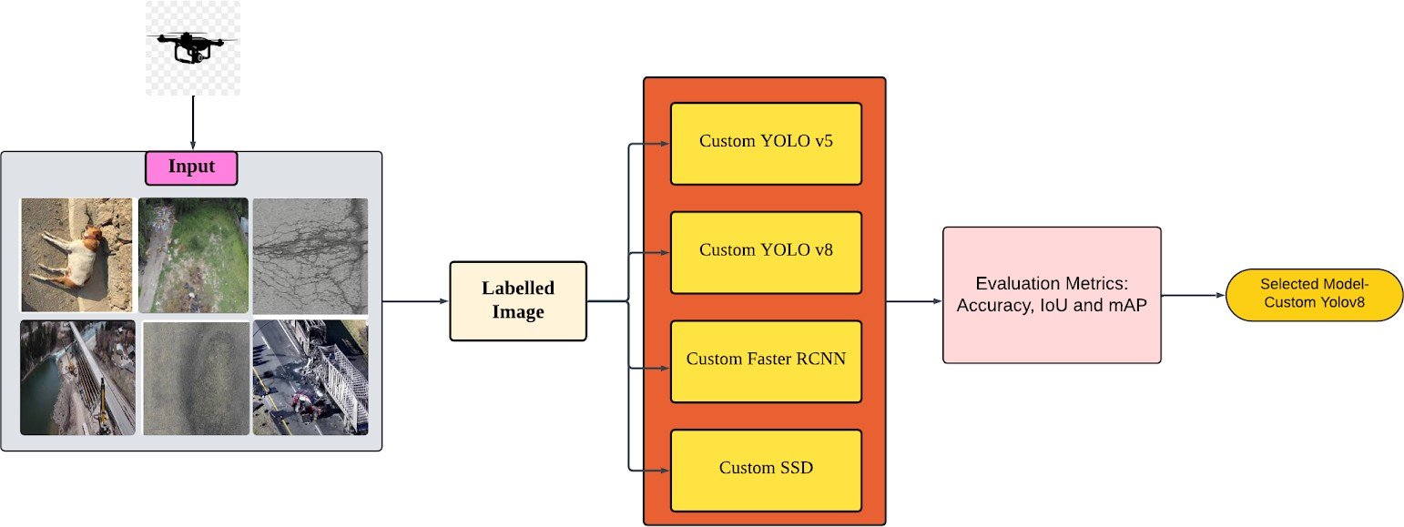
Stage 1 - Model Selection
For stage 1 modelling, we have experimented with 4 models – Custom Yolo V5, Yolo V8, Faster RCNN and SSD.
We then compared the evaluation metrics of all the 4 models.
Custom Yolo V8 outperformed the rest of the models.

Slide 19
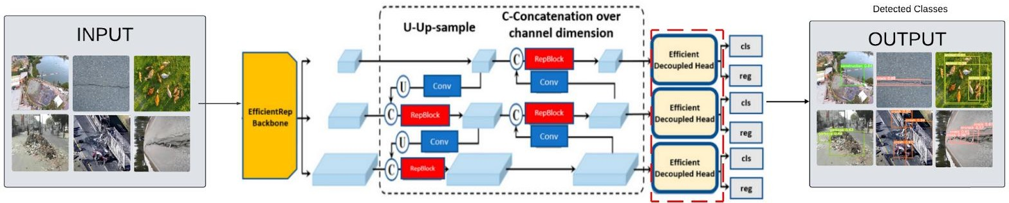
Stage 1 - UAV Yolo v8
Base Model: Derived from pre trained YOLO v8, originally trained on COCO dataset with 80 classes and 2.5M images.
Improved Model: Improvisations made to the baseline Yolo V8 model are
Customized Head: Modified for our task, focusing on 6 specific object classes.
PANet Integration: Utilizes Path Aggregation Network for enhanced multi-scale feature extraction.
Powerful Backbone: Retains YOLO v8's robust backbone for feature extraction.

Slide 20
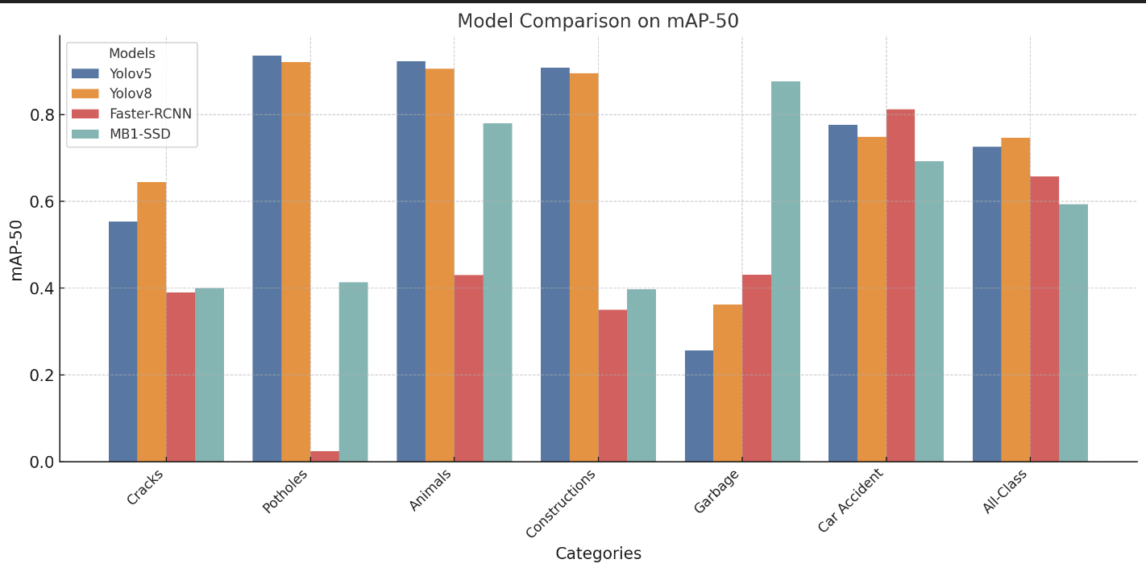
Stage 1 - Model Comparison

Slide 21
Stage 1 - Model Comparison
Model | Cracks | Pothole | Animal | Construction | Garbage | Car Accident | All Class
Yolo V5 | 0.554 | 0.936 | 0.924 | 0.908 | 0.257 | 0.777 | 0.726
UAV Yolo V8 | 0.645 | 0.921 | 0.906 | 0.896 | 0.362 | 0.749 | 0.747
Faster- RCNN | 0.39 | 0.025 | 0.43 | N/A | N/A | N/A | N/A
MB1- SSD | 0.4 | 0.414 | 0.780 | 0.3977 | 0.877 | 0.692 | 0.594

Slide 22
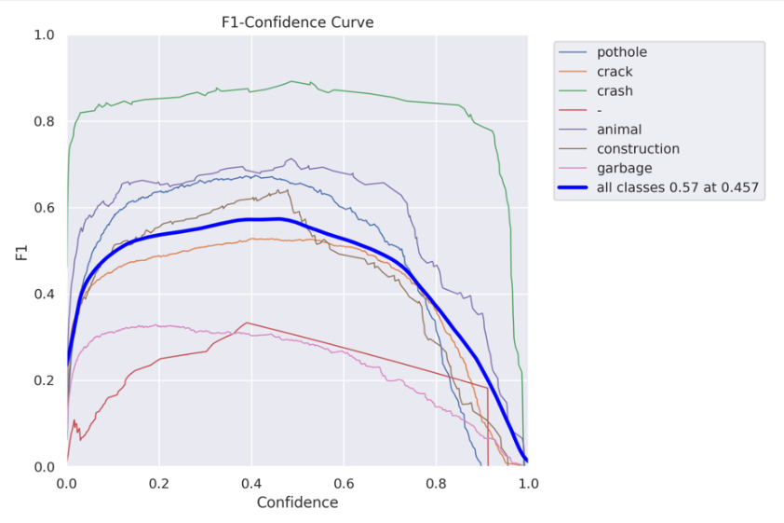
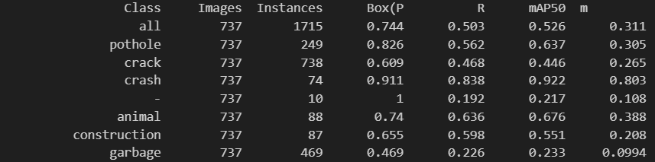
Evaluation results of the Stage 1 model – UAV Yolo V8
High Accuracy: Achieved the best detection results for crashes with mAP50 of 0.922 and box precision of 0.911.
Strong Results: Pothole detection demonstrated robust performance with mAP50 of 0.637 and box precision of 0.826.
Reliable Detection: Consistent accuracy observed in other obstacle categories.

Slide 23
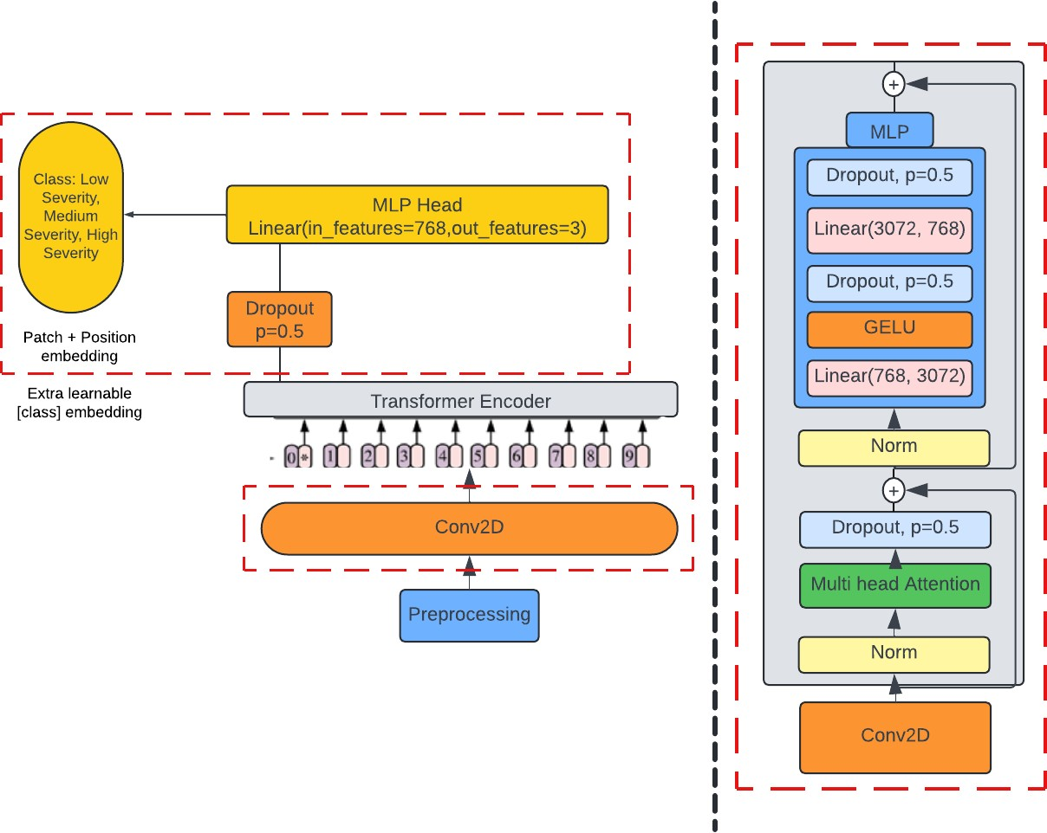
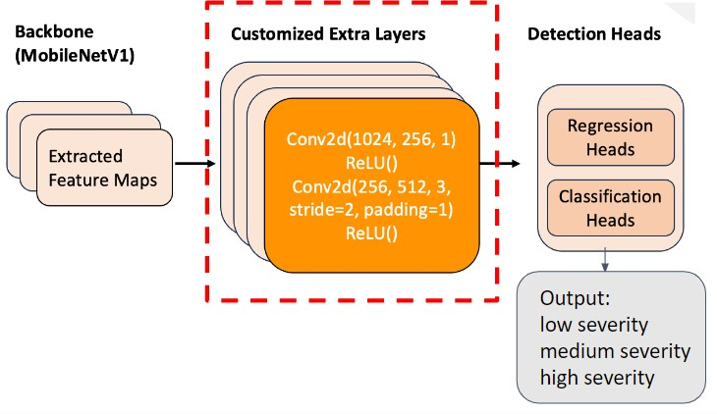
Stage 2 - Modelling
UAV ViT model
UAV MB1-SSD model
Stage 2 modeling focusses on severity classification of the categories detected by the stage 1 model.
We built 6 category specific severity classification models using majorly 2 baseline models – Vision transformer(ViT) and MobileNet- Single shot detection(MB1-SSD).
We have also built a 7th model – Aggregation Model which aggregates results by counting detected objects and organizing them by severity levels.

Slide 24
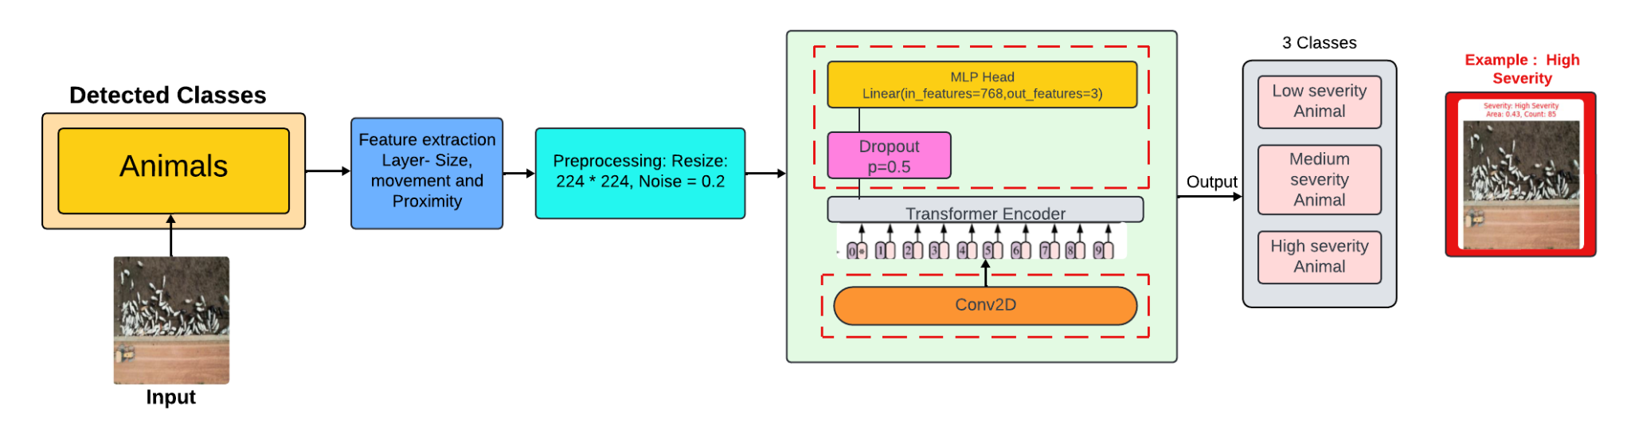
Animal Severity Classification UAV-ViT Model
Base Model: Derived from the pretrained Vision Transformer (ViT) model, originally trained on large-scale image datasets for general image classification.
Improved Model: Enhancements made to the base ViT model include
Feature selection: For animal severity classification, size, proximity and movement of the animal is considered. Area occupied and count of the animal is considered for severity classification
Replaced the Patch embedding layer with Conv2D layer for pixel to pixel division of the image
Added a dropout layer (p=0.5) to improve the model’s performance.
Only 3 classes are used – Low, medium and high severity

Slide 25
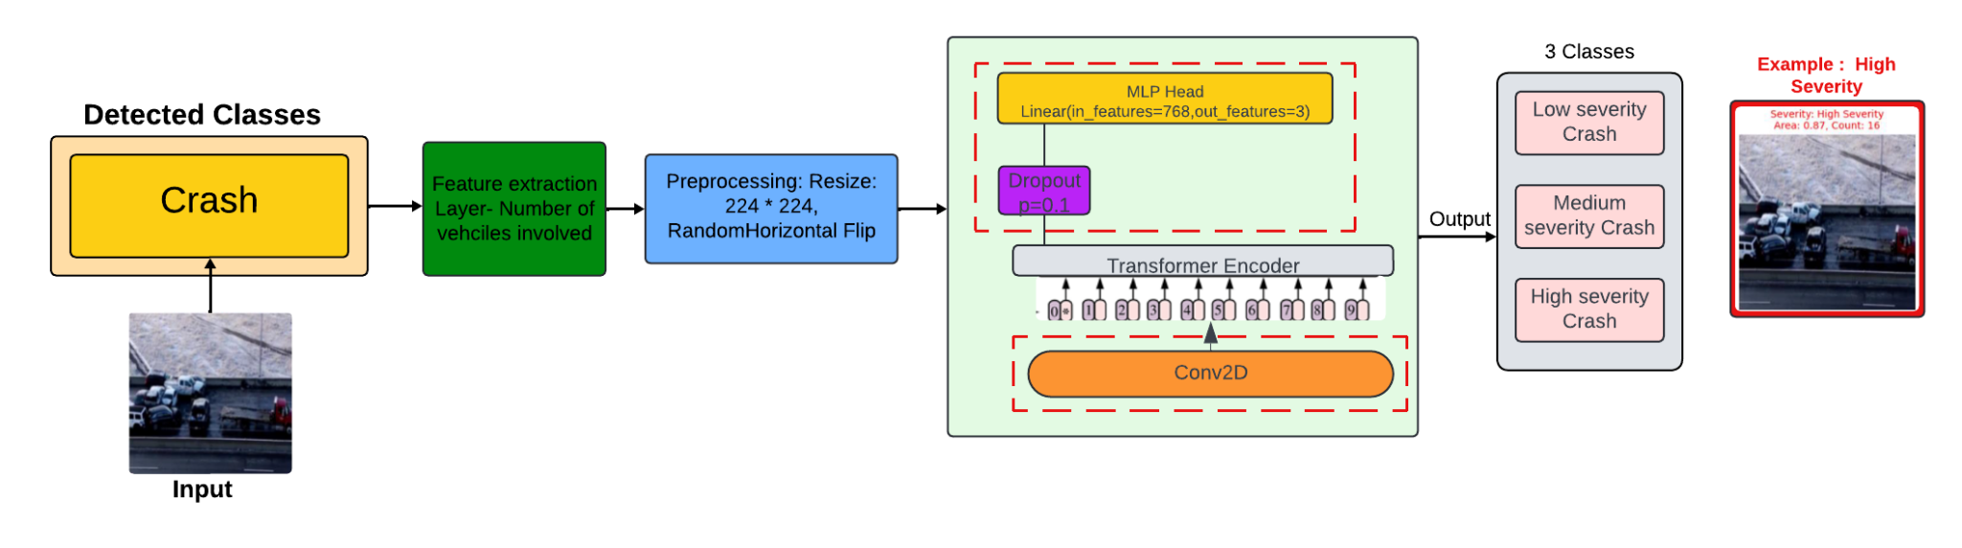
Accident Severity Classification UAV-ViT Model
Base Model: The base Vision Transformer (ViT) utilizes self-attention and patch-based embeddings for efficient image classification.
Improved Model: Improvements made to the base ViT model include
Feature selection: For crash severity classification, count of number vehicles involved in the crash are considered.
Preprocessing of the image included resizing (224 *224) and Random Horizontal flip.
Added a dropout layer (p=0.1) to improve the model’s performance.
Gaussian error Linear Unit(GeLU) activation function is used as to enhance non-linearity and to capture more patterns

Slide 26
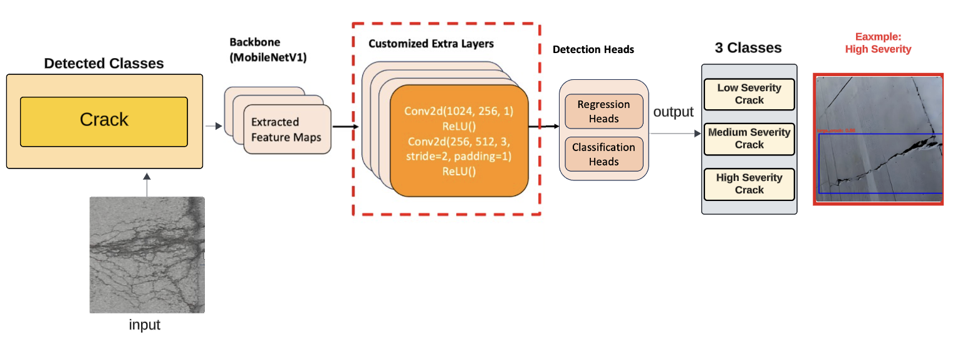
Crack Severity Classification UAV MB1-SSD Model
Base Model: MB1-SSD, which is a variation of SSD, is known for its speed and efficiency.
Improved Model:
Extra Layers: 1x1 and 3x3 convolutions (stride 2, padding 1) are added to enhance feature extraction and capture road crack details.
Heads Improvement: Using Soft-NMS (Soft Non-Maximum Suppression) to help retain valid detections that are close to each other.
Depth of the crack and size of the crack are considered for the severity classification.

Slide 27
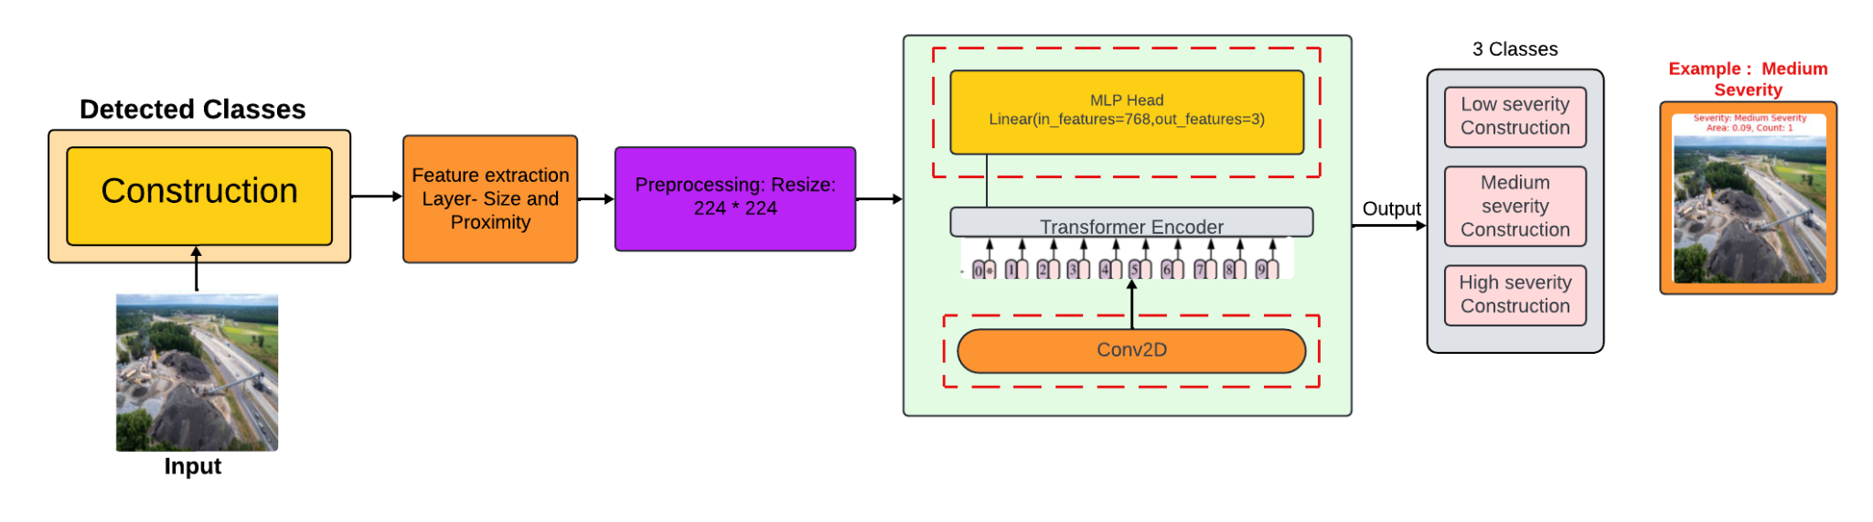
Construction Activity Severity Classification UAV-ViT Model
Base Model: The inspiration for the base model is a Vision Transformer (ViT)which uses a patch-based approach for image classification tasks.
Improved Model: Enhancements made to the base ViT model include
Feature selection: For Construction severity classification, size and proximity of the construction are considered.
Replaced the Patch embedding layer with Conv2D layer for pixel to pixel division of the image
Updated the MLP head with a linear layer that processes 768 features for more accurate classification.

Slide 28
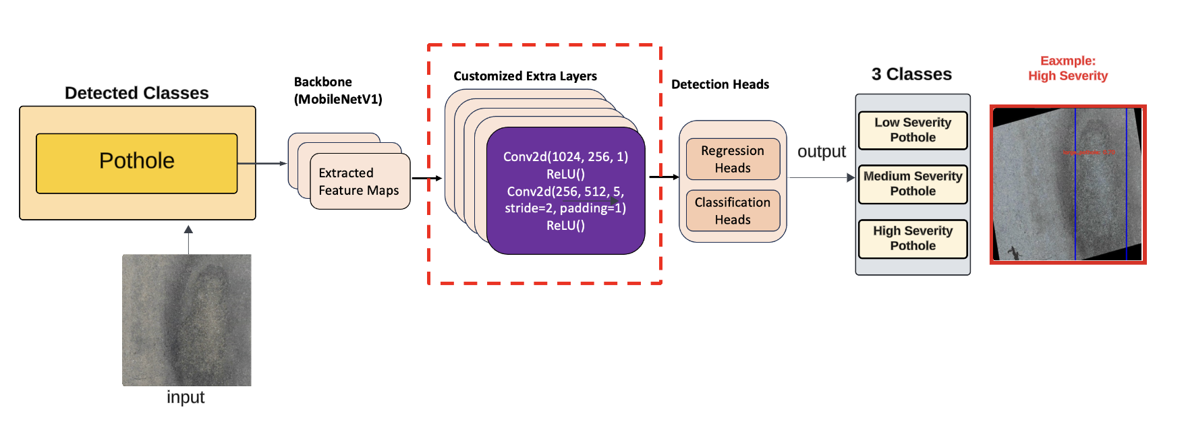
Pothole Severity Classification UAV MB1-SSD Model
Base Model: MB1-SSD, which is a variation of SSD, is known for its speed and efficiency.
Improved Model:
Extra Layers: 1x1 and 5x5 convolutions (stride 2, padding 1) are added to enhance feature extraction and capture road pothole details.
Heads Improvement: Using Soft-NMS (Soft Non-Maximum Suppression) to help retain valid detections that are close to each other.
Size and depth of the pothole are considered for severity classification.

Slide 29
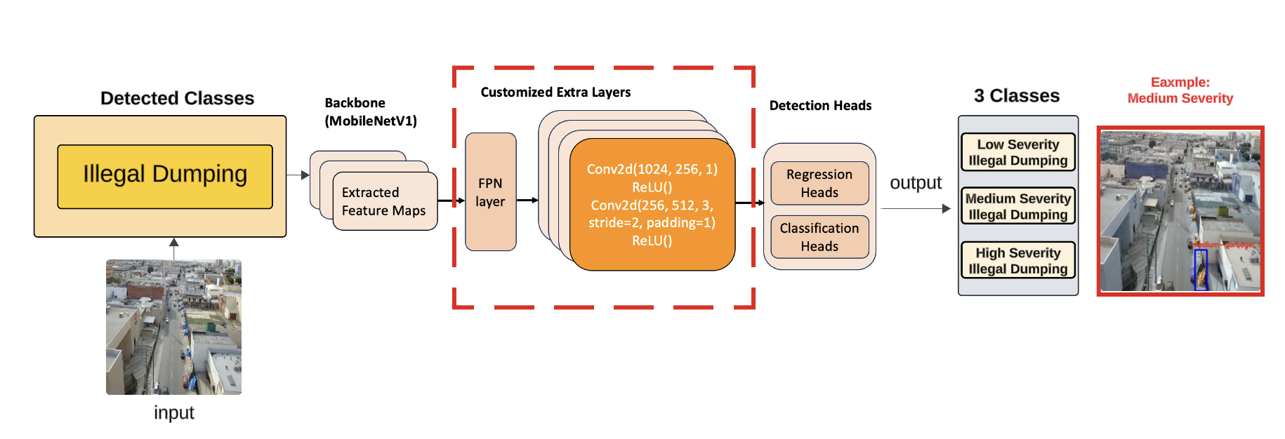
Illegal Dumping Severity Classification UAV MB1-SSD Model
Base Model: MB1-SSD, which is a variation of SSD, is known for its speed and efficiency.
Improved Model:
Extra Layers: 1x1 and 3x3 convolutions (stride 2, padding 1) are added to enhance feature extraction
FPN layer: Use a combination of upsampling and downsampling techniques to merge features from different levels. To better capture Various types of garbage that extracted from the backbone network.
Area occupied is considered for severity classification.

Slide 30
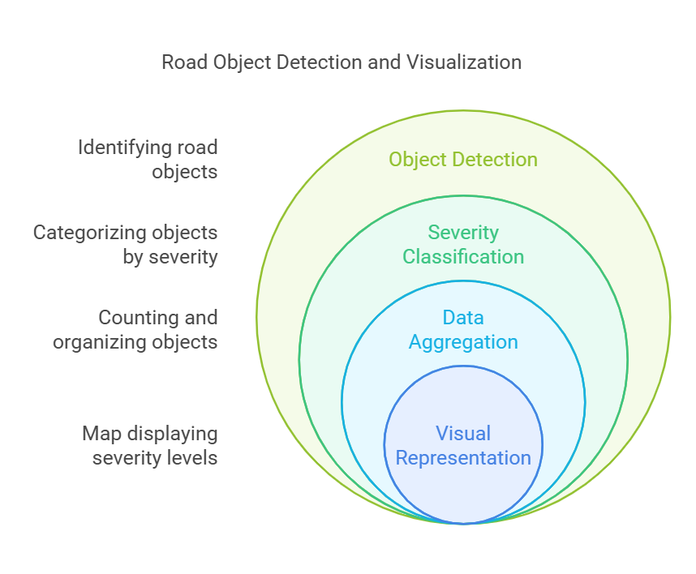
UAV Aggregation Model
Aggregation Model Overview: The aggregation model consolidates the results from the six detection models, counting the objects and classifying them by severity (low, moderate, high) for effective prioritization.
Data Organization by Severity Levels: It organizes the detected objects into severity categories, helping to identify the most critical areas requiring immediate attention.
Visualization of Aggregated Data on Map: The aggregated data is visually represented on a map, where different colors indicate varying severity levels (low, moderate, high) of detected objects.
Color-Coded Severity Representation: The map uses color codes to highlight areas with different severity levels, enabling quick identification of critical regions that need attention.

Slide 31
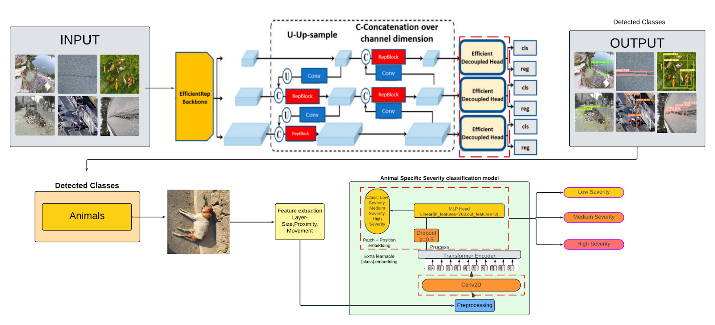
Sample Model and Data flow pipeline

Slide 32
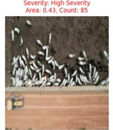
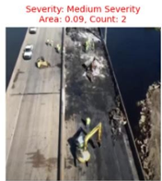
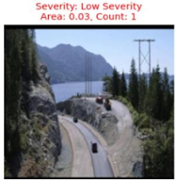
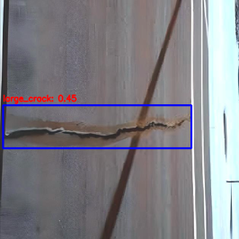
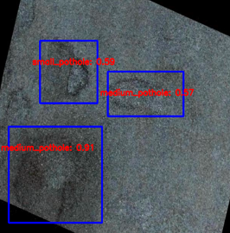
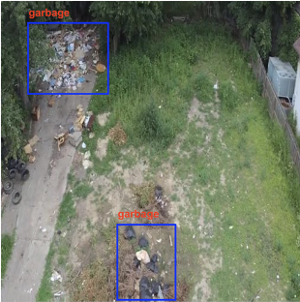
Stage 1: The system identifies the obstacle type and dynamically activates the specific model tailored for that category.
Stage 2: Distinct models, each trained exclusively on their respective categories, perform severity classification. The models demonstrate strong performance, as evidenced by high mAP scores.

Slide 33
Category specific Base Models with a Fine-Tuned Model Comparison
Model Comparison on mAP-50
Model name | Base Model | Fine-tuned Model
Animal Category specific severity classification Model | 52% | 90%
Accident Category specific severity classification Model | 71% | 78%
Construction Category specific severity classification Model | 63% | 78%
Cracks Category specific severity classification Model | 59% | 88%
Pothole Category specific severity classification Model | 52% | 85%
Garbage Category specific severity classification Model | 17% | 80%

Slide 34
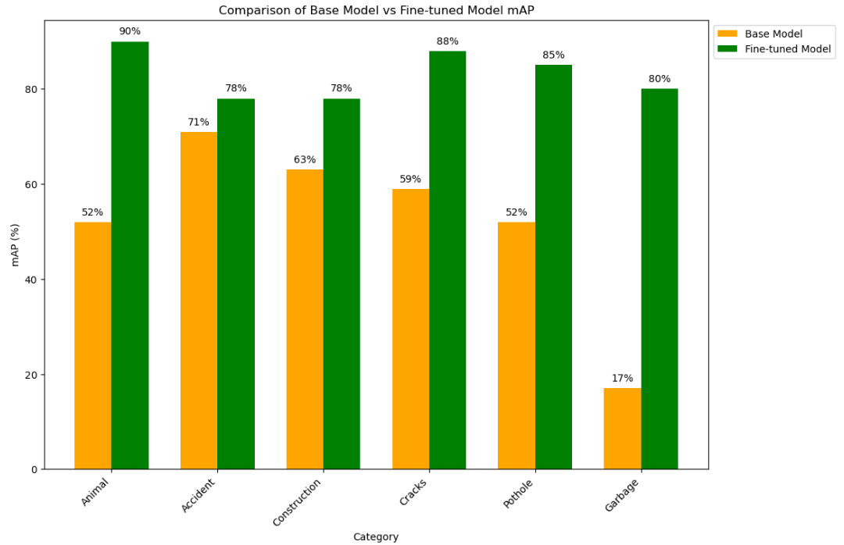
Base Model with a Fine-Tuned Model Comparison
Model Comparison on mAP-50

Slide 35
Model Results – Accuracy and Precision Comparison
Model name | Accuracy | Precision
Animal Category specific severity classification Model | 77% | 78%
Accident Category specific severity classification Model | 90% | 95%
Construction Category specific severity classification Model | 81% | 80%
Cracks Category specific severity classification Model | 86% | 88%
Pothole Category specific severity classification Model | 87% | 85%
Garbage Category specific severity classification Model | 85% | 81%

Slide 36
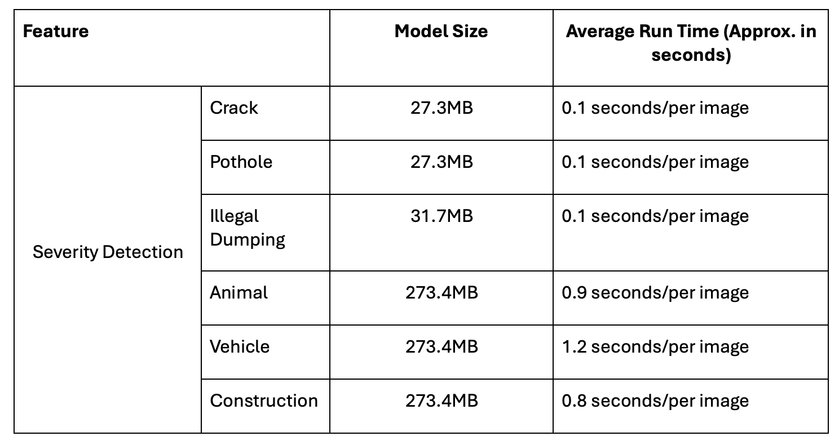
Model Size and Running Time Comparison

Slide 37
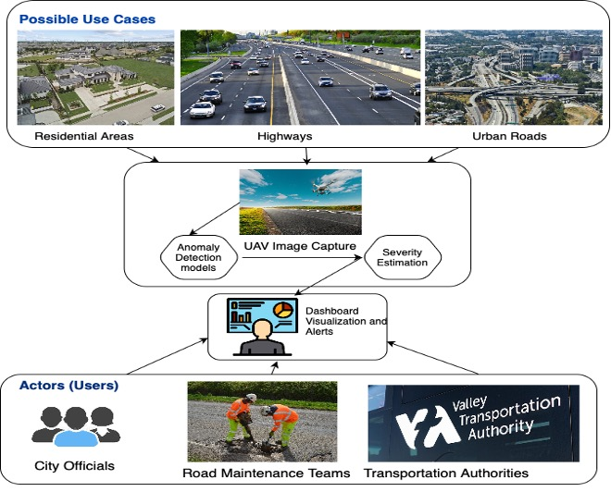
Web Portal System Development
System Use Cases:

Slide 38
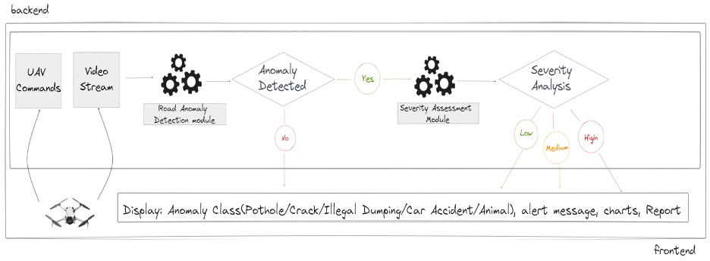
System Architecture and Infrastructure
Frontend & Backend System Architecture

Slide 39
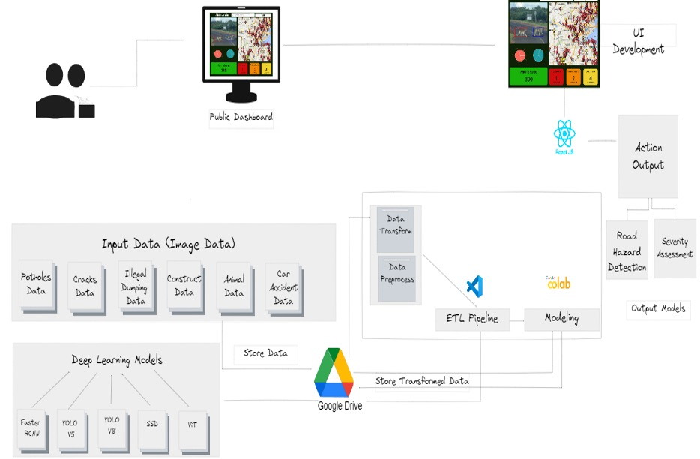
System Architecture and Infrastructure
Frontend & Backend System Architecture

Slide 40
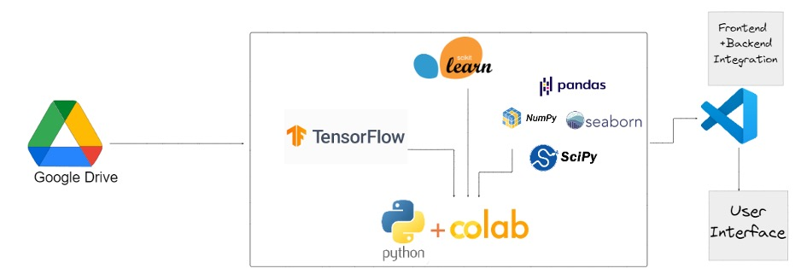
Supporting Platforms, Frameworks, and Tools
Category | Name
System Supporting Platforms | Google Drive
 | GitHub
 | Jupyter Notebook
System Supporting Tools | Visual Studio Code (VS Code)
 | Lucidchart
 | Excalidraw
System Supporting Framework | React JS + Bootstrap
 | Python FastAPI
 | OpenCV (cv2)
 | TensorFlow Hub

Slide 41



System Implementation – Web application
Login and SignUp Page

Slide 42
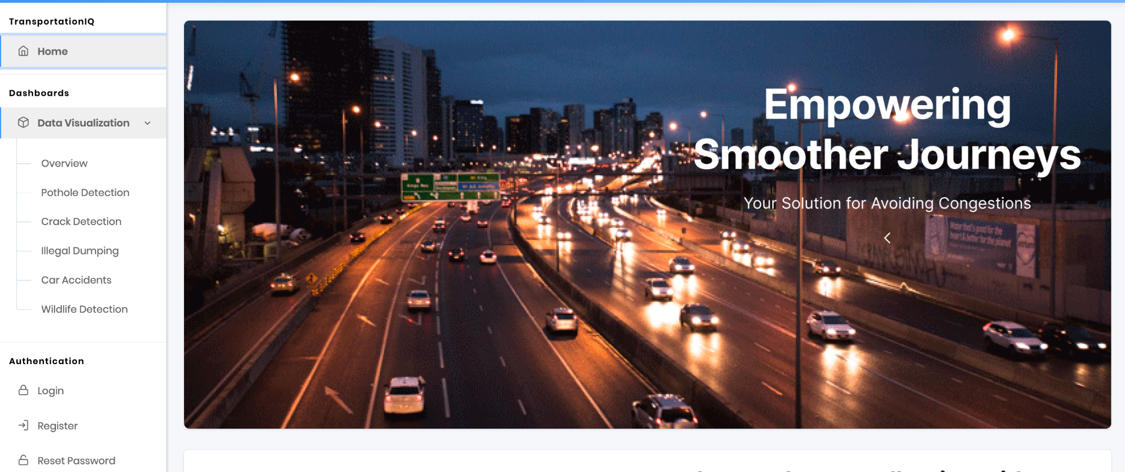
Home Page

Slide 43
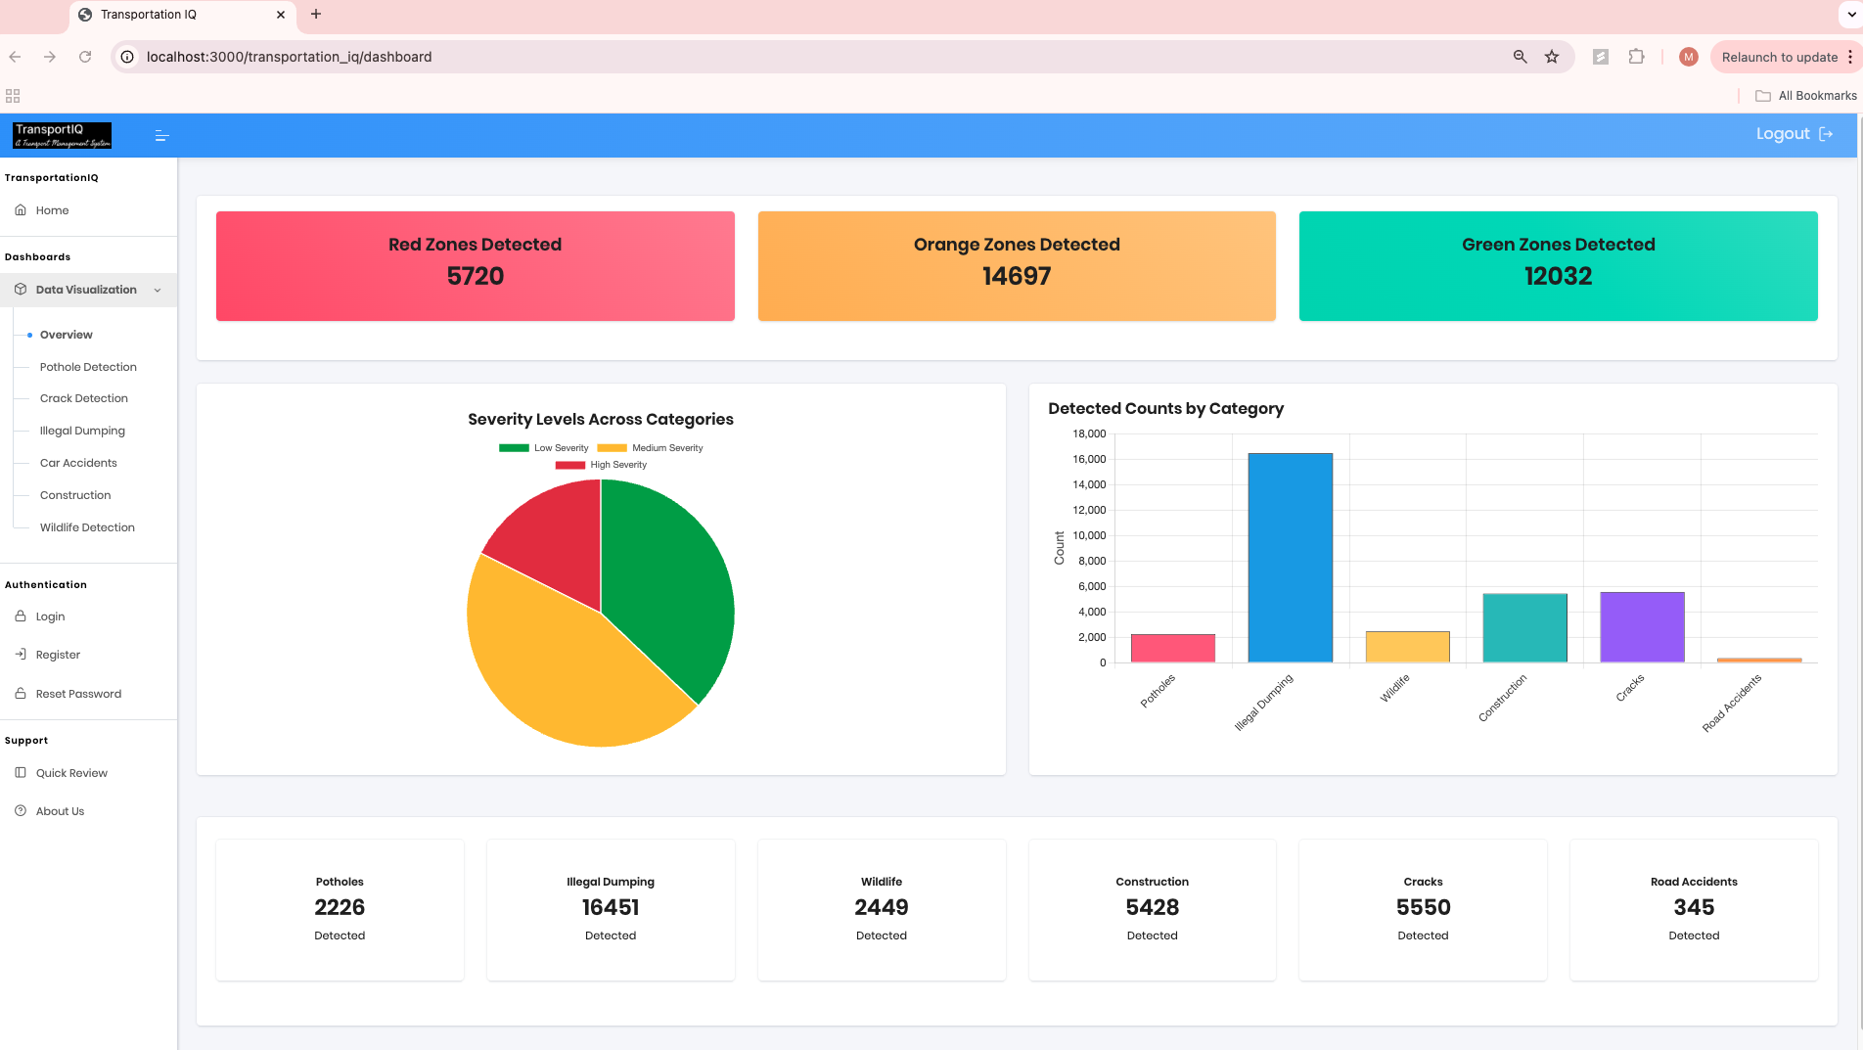
Dashboard Overview

Slide 44

About Us Page

Slide 45


Slide 46

System Demo and Testing

Slide 47
Literature Survey
•The literature review presented a thorough summary of current research in the field, showcasing various detection models utilized in diverse urban settings.
•Deep learning frameworks like YOLO and CNN models play a crucial role in vehicle identification,detecting unauthorized waste disposal, and monitoring safety activities on construction sites.Model comparison showed that VGG-19, U-net DCNNs, SVM classification, and SWM algorithms are effective in identifying road anomalies such as cracks, litter, potholes, and vehicle accidents.
•Advanced models such as AAE and ResNet50 with Feature Pyramid Network were studied for detecting illegal activities like unauthorized waste disposal, showing promise in advanced detection technology to improve safety, sustainability, and efficiency in cities.
Detection Models | Data Source | Urban Area | Altitude | Measurements | Ref Paper
YOLO | Custom | Roads and Highways | Various | Vehicle Detection | [1]
CNN models- SSD-500and YOLO V3 | Custom | Street & desserts | Various | Cattle Detection | [2]
Faster R-CNN, SSD, YOLOv5, YOLOv7, and YOLOv8 | Custom | Highway, forest, deserts | Various | Animal Detection | [3]
Faster R-CNN and YOLOv3 | Custom | Construction Sites | Various | Construction | [4]
Faster RCNN, Cascade CNN, R-FCN, YOLO | Custom | Object detection | Various | Animals | [5]
CNN models | Custom | Roads, Forests | Various | Wild Animals | [6]
VGG- 19 and U-net DCNNs. | CRACK500 | Roads | Various | Cracks Detection | [7]
Faster-RCNN, YOLOv5s,YOLOv7-tiny, andYOLOv8s | CRACK500 | Roads | 22.5 m | target detection, crack detection, road damage evaluation | [8]
CNN VGG16 | SDNet | Roads | Various | Cracks Detection | [9]
SVM classification | Custom | Highways | Various | Cracks Detection | [10]

Slide 48
Literature Survey
SWM, simple linear iterative clustering (SLIC) | Custom | Small streets and Roads | Various | Litter Detection | [11]
CNN1, CNN2 | Custom | Parks, Beaches, Streets | Various | Garbage Detection | [12]
SSD, YOLOv3, YOLOv4 | UAV Dataset | Roads, Parking lots,sidewalks, parks, etc. | Various | Garbage Detection | [13]
YOLOv3 | Custom | Streets, Roads, sidewalks,parks, etc. | Various | Domestic Garbage Detection | [14]
HFCN and UNet++ | Custom | Roads | Various | Road Garbage Segmentation | [15]
AAE models | Custom | Streets, Roads, sidewalks,parks, etc. | Various | Illegal dumping Detection | [16]
ResNet50 and Feature Pyramid Network(FPN) | Custom | Streets, Roads, sidewalks,parks, etc. | Various | Illegal Landfills Detection | [17]
YOLOv5 | Custom Dataset | highway | Various | Potholes and Cracks Detection, Classification | [18]
Tiny Yolo Object detection,CNN | Online Open Source And Custom Dataset | Road | Various ranges of height up to 30m | Pothole Detection | [19]
YOLOv3–ResNet101 | consecutive RGB frame of custom video | highways | Various | Pothole Detection | [20]
Faster R-CNN, and SSD models | Custom Dataset | road | Various | Debris caused by Vehicle Accidents Detection | [21]
Convolutional LSTM(ConvLSTM) | Custom Dataset | road | Various ranges of height | Crashed Car Detection,Classification | [22]

Slide 49
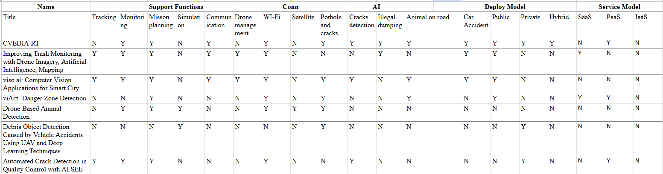
Technology Survey
•The technology survey found a wide range of systems addressing different urban issues such as illegal dumping, garbage detection, potholes, construction activities, and dead animal detection.
•UAV systems combined with cutting-edge models have been shown to improve effectiveness,precision, and security in the upkeep of urban infrastructure.
•Machine learning, especially advanced deep learning frameworks such as YOLO, CNN models, and Faster R-CNN, have significantly contributed to identifying road irregularities and dangers. This has led to enhancements in road quality, transportation management, and urban resilience.

Slide 50
References - 1
Aburasain, R. Y., Edirisinghe, E. A., & Albatay, A. (2020). Drone-Based Cattle Detection Using Deep Neural Networks. Retrieved from
https://link.springer.com/chapter/10.1007/978-3-030-55180-3_44
Akinsemoyin, A., Awolusi, I., et al. (2023). Unmanned Aerial Systems and Deep Learning for Safety and Health Activity Monitoring on Construction Sites.
Alam, H., Valles, D., et al. (2020). Debris Object Detection Caused by Vehicle Accidents Using UAV and Deep Learning Techniques. Retrieved from https://ieeexplore.ieee.org/document/9623110
American Society of Civil Engineers. (2020). 2020 Report card for America's infrastructure. Retrieved from https://infrastructurereportcard.org/

Slide 51
References - 2
Chen, X., Liu, C., Chen, L., Zhu, X., Zhang, Y., & Wang, C. (2024). A Pavement Crack Detection and Evaluation Framework for a UAV Inspection System Based on Deep Learning. Applied Sciences, 14(3), 1157. https://doi.org/10.3390/app14031157
Chen, X., Liu, C., et al. (n.d.). A Pavement Crack Detection and Evaluation Framework for a UAV Inspection System Based on Deep Learning. Retrieved from https://www.mdpi.com/2076-3417/14/3/1157
Choi, D., Bell, W., et al. (n.d.). UAV-Driven Structural Crack Detection and Location Determination Using Convolutional Neural Networks. Retrieved from https://www.mdpi.com/1424-8220/21/8/2650
Elamin, A., Rabbany, A., et al. (n.d.). UAV-Based Pavement Crack Detection Using Deep Convolutional Neural Networks.
Gao, J. (2023). Smart City Drone Cloud and Machine Learning. IEEE Future Technology Summit - UAV Track in Taiwan. Retrieved from https://www.researchgate.net/publication/372519283

Slide 52
References - 3
Johnson, B., et al. (2020). Enhancing Transportation Infrastructure Management Through UAV Technology. Transportation Research Part A: Policy and Practice, 72, 98-112.
Javan, F. D., Zarrinpanjeh, N., et al. (n.d.). Automatic Crack Detection of Road Pavement Based on Aerial UAV Imagery.
Kamilaris, A., Ahmed, F., et al. (n.d.). DumpingMapper: Illegal dumping detection from high spatial resolution satellite imagery.
Khare, O. M., Gandhi, S., Rahalkar, A. M., & Mane, S. (2023). YOLOv8-Based Visual Detection of Road Hazards: Potholes, Sewer Covers, and Manholes. arXiv:2311.00073. Retrieved from https://arxiv.org/abs/2311.00073
Kraft, M., Piechocki, M., & Ptak, B. (2021). Autonomous, Onboard Vision-Based Trash and Litter Detection in Low Altitude Aerial Images Collected by an Unmanned Aerial Vehicle. Remote Sensing, 13(5), 965. https://doi.org/10.3390/rs13050965

Slide 53
References - 4
Liao, Y.-H., & Juang, J.-G. (2022). Real-Time UAV Trash Monitoring System. Applied Sciences, 12(4), 1838. https://doi.org/10.3390/app12041838
Liu, W., Anguelov, D., Erhan, D., Szegedy, C., Reed, S., Fu, C. Y., & Berg, A. C. (2016). SSD: Single Shot MultiBox Detector. In European Conference on Computer Vision (pp. 21–37). Springer, Cham.
Lun, Z., Pan, Y., et al. (n.d.). Skip-YOLO: Domestic Garbage Detection Using Deep Learning Method in Complex Multi-scenes.
Murthy, C. B., Hashmi, M. F., & Keskar, A. G. (2021). Optimized MobileNet + SSD: A Real-Time Pedestrian Detection on a Low-End Edge Device. International Journal of Multimedia Information Retrieval, 10, 171–184.
https://link.springer.com/article/10.1007/s13735-021-00212-7

Slide 54
References - 5
National Highway Traffic Safety Administration. (2019). Traffic Safety Facts 2019: A Compilation of Motor Vehicle Crash Data from the Fatality Analysis Reporting System and the General Estimates System. Retrieved from https://crashstats.nhtsa.dot.gov/
Rančić, K., Blagojević, B., & Bezdan, A. (2023). Animal Detection and Counting from UAV Images Using Convolutional Neural Networks. Retrieved from https://www.mdpi.com/2504-446X/7/3/179
Redmon, J., & Farhadi, A. (2018). YOLOv3: An Incremental Improvement. arXiv preprint. Retrieved from https://arxiv.org/abs/1804.02767
Schmitt, A., et al. (n.d.). Litter on the Streets - Solid Waste Detection Using VHR Images. Retrieved from Doi/full/10.1080/22797254.2023.2176006

Slide 55
References - 6
Serrano, S. R., Torres, G. S., et al. (n.d.). Automatic Detection of Traffic Accidents from Video Using Deep Learning Techniques. Retrieved from https://www.mdpi.com/2073-431X/10/11/148
Sharma, P., et al. (n.d.). Detection of Different Sizes of Potholes on Roads Using a Drone and Generating Warnings for Vehicles.
Smith, J., et al. (2018). Economic Impacts of Potholes on Developed Nations: A Comprehensive Analysis. Journal of Transportation Economics, 25(3), 112–125.
Torres, R. N., et al. (n.d.). Learning to Identify Illegal Landfills through Scene Classification in Aerial Images. Retrieved from https://www.mdpi.com/2072-4292/13/22/4520

Slide 56
References - 7
Truong, L. N. H., Mora, O. E., Cheng, W., Tang, H., & Singh, M. (2021). Deep Learning to Detect Road Distress from Unmanned Aerial System Imagery. Transportation Research Record, 2675(9), 776–788. https://doi.org/10.1177/03611981211004973
United Nations. (2019). World Urbanization Prospects: The 2018 Revision. Retrieved from https://population.un.org/wup/
Verma, V., Gupta, D., Gupta, S., et al. (n.d.). A Deep Learning-Based Intelligent Garbage Detection System Using an Unmanned Aerial Vehicle. Retrieved from https://www.mdpi.com/2073-8994/14/5/960
Wang, D., Liu, Z., et al. (n.d.). Automatic Detection of Pothole Distress in Asphalt Pavement Using Improved Convolutional Neural Networks. Retrieved from https://www.mdpi.com/2072-4292/14/16/3892
Yan, H., & Zhang, J. (2023). UAV-PDD2023: A Benchmark Dataset for Pavement Distress Detection Based on UAV Images. Retrieved from https://www.sciencedirect.com/science/article/pii/S2352340923007710#sec0003

Slide 57
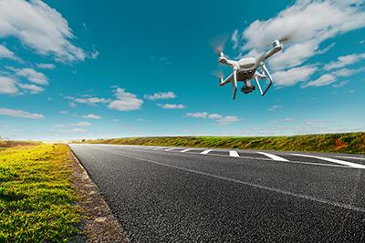
Thank You

